Slide 1
MARKETING MIX MODELS (MMM)
Dr. Ceren Kolsarici

Slide 2
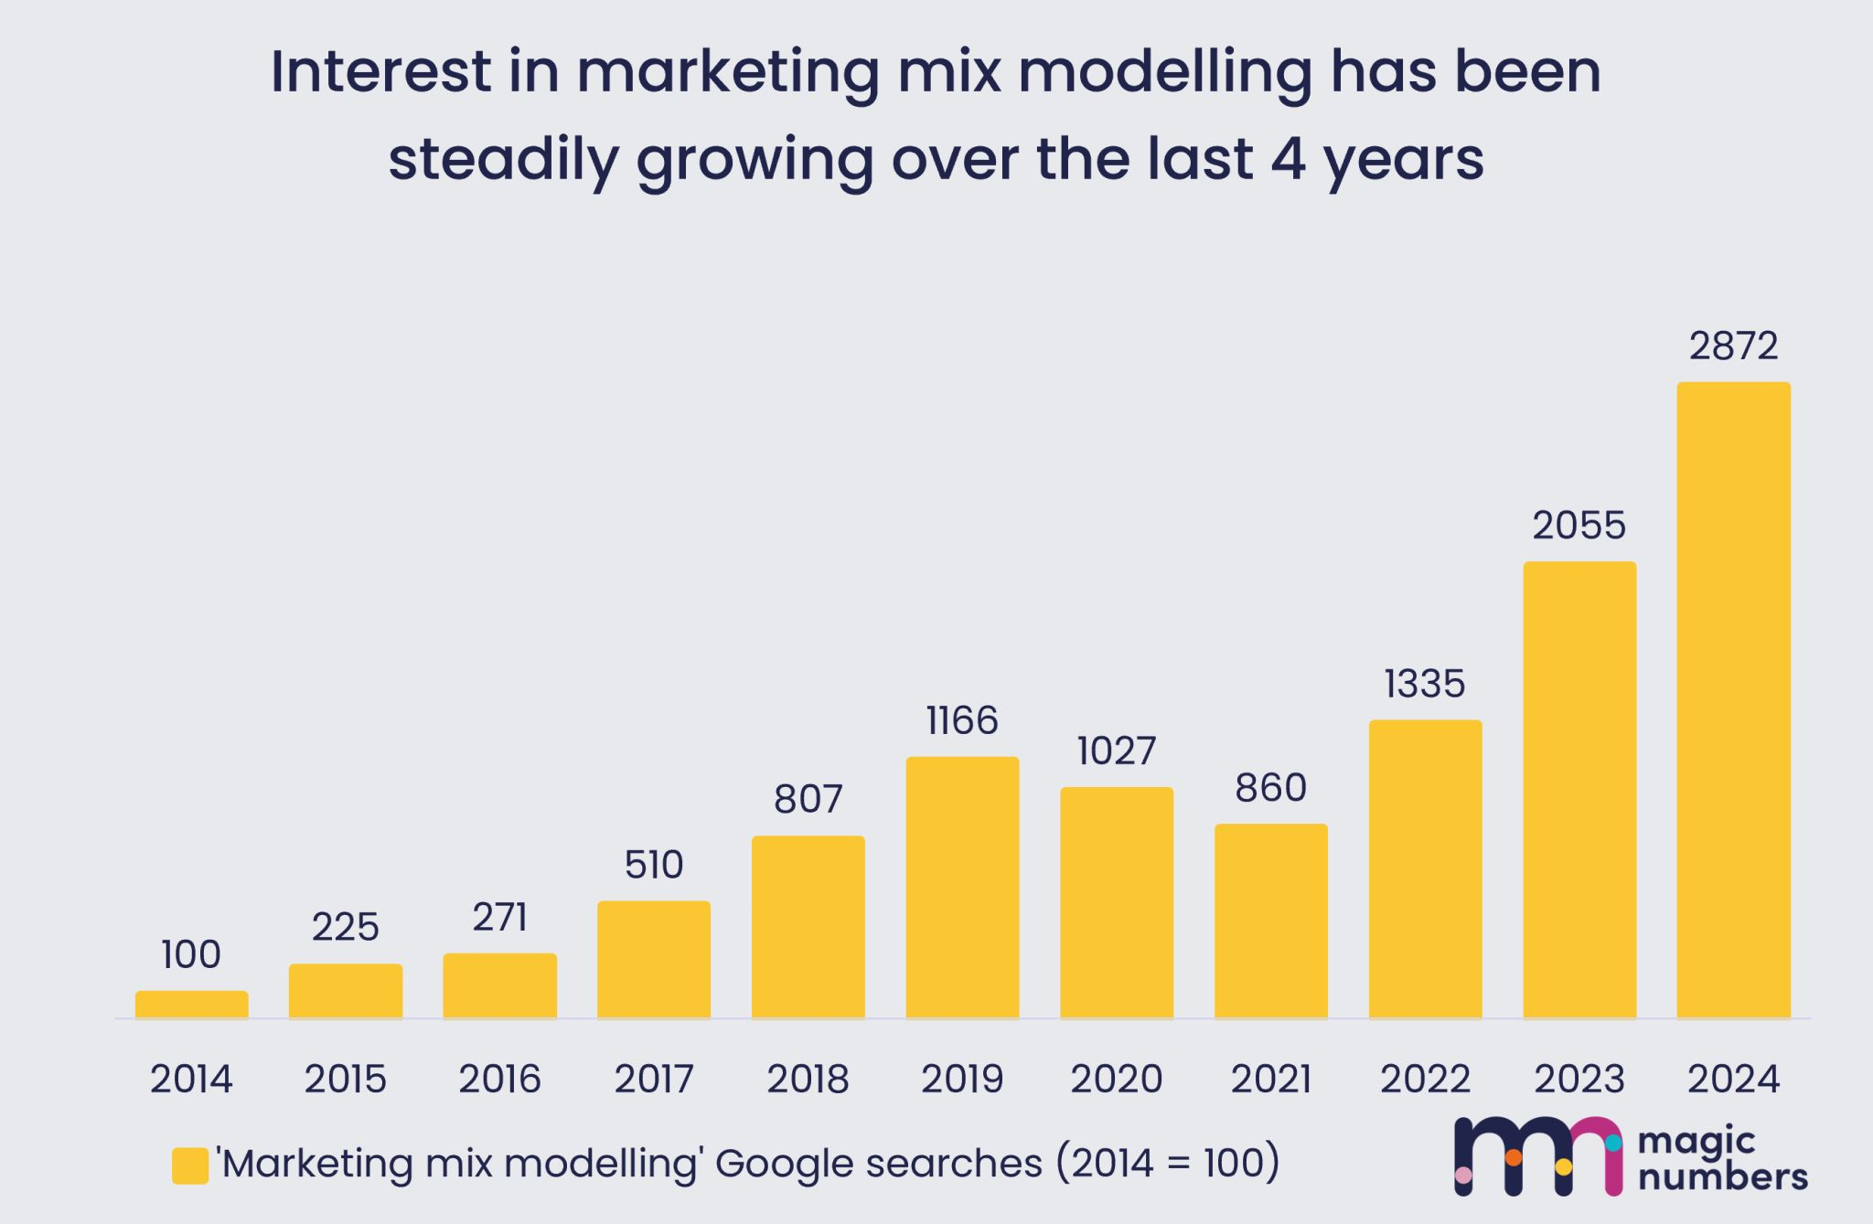
The New Normal: Cookieless World
Reject Modernity, Embrace Tradition
MMM is making a comeback.
Data privacy regulations led to platforms removing 3rd party cookies, which pulled the rug from under multi-touch attribution (MTA)
Ready to plug in solutions from the Big Three: Google (Meridian), Meta (Roybn) and more recently Amazon
CAUTION:
Finding the “right” MMM is a combination of Art & Science
(you can’t throw things at the wall and wait to see what sticks)

Slide 3
DECIPHERING THE CODE
OVERVIEW

Slide 4
Marketing Actions
(Inputs)
Observed Market
Outputs
Competitive Actions
(2)
Product Design
Price
Advertising
Selling Effort
…
Market
Response
Model
Awareness Level
Preference Level
Sales Level
….
(1)
(4)
(3)
Environmental Conditions
Objectives
Control, Adaption (6)
Evaluation
(5)

Slide 5

What is a Model?
A model is a stylized representation of reality that is easier to deal with and explore for a specific purpose than reality itself.
We could have a verbal model, box and arrow model, graphical model, mathematical model, or a spreadsheet model.
How do new products/ideas diffuse in the market?

Slide 6
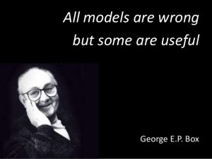
Start with asking the right question
Understand the business and how your marketing works
Represent the phenomena in mathematical form
If you are unsure of how something works, ask the data
Estimate, benchmark, find the “best” model for your data
Interpret and generate actionable insights

Slide 7
MARKETING MIX MODELS (mmm)
TECHNICAL DETAILS

Slide 8
Typology of Marketing Mix Models
Univariate versus Multivariate Models
Monopoly versus Competition Models
Linear versus Non-linear Models (Nature of the Response Function)
Static versus Dynamic Models
Individual versus Aggregate Models
Category versus Brand-level Models (Level of Demand Analyzed)
Descriptive versus Predictive versus Normative Models (Intended Use)

Slide 9
Modeling Terminology
A simple model:
Parameters: Values that need to be determined based on the information (data)
Calibration: The process of determining appropriate parameter values via estimation, judgment, or a hybrid approach
Variables: The values that change through time/observations and are provided to the model
Independent variables: Environmental, or decision variables
Dependent variables: Uncontrollable, outcome variables
Calibrated
SALES = a + b x ADVERTISING
SALES = 23,000 + 4 x ADVERTISING

Slide 10
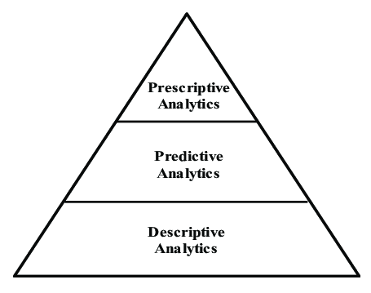
Analytics Sophistication Pyramid

Slide 11
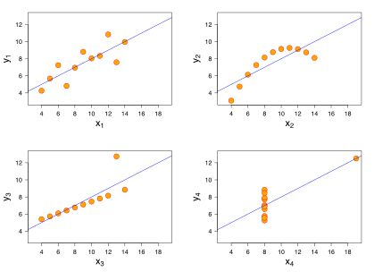
Visualize First, then Build your Model
Anscombe’s quartet, assembled by the statistician Francis Anscombe in 1973, highlights the importance of visualizing data before analyzing it.
X and Y
Same mean
Same variance
Same correlation
Upon estimation
Leads to the exact same
linear regression parameters

Slide 12
A Simple Model
Y (Sales Level)
} b (slope of the
salesline)
a
(sales level when
advertising = 0)
}
1
X (Advertising)

Slide 13
Marketing Phenomena (Modeling with Intention)
Think:
Which marketing variable would this work for?
How can we introduce these into the model?
P1: Through Origin
P2: Linear
Y
Y
X
X
P3: Decreasing Returns (concave)
P4: Saturation
—
Q
Y
Y
X
X

Slide 14
Marketing Phenomena (Modeling with Intention)
Think:
Which marketing variable would this work for?
How can we introduce these into the model?
P5: Increasing Returns
(convex)
P6: S-shape
Y
Y
X
X
P7: Threshold
P8: Super-saturation
Y
Y
X
X

Slide 15
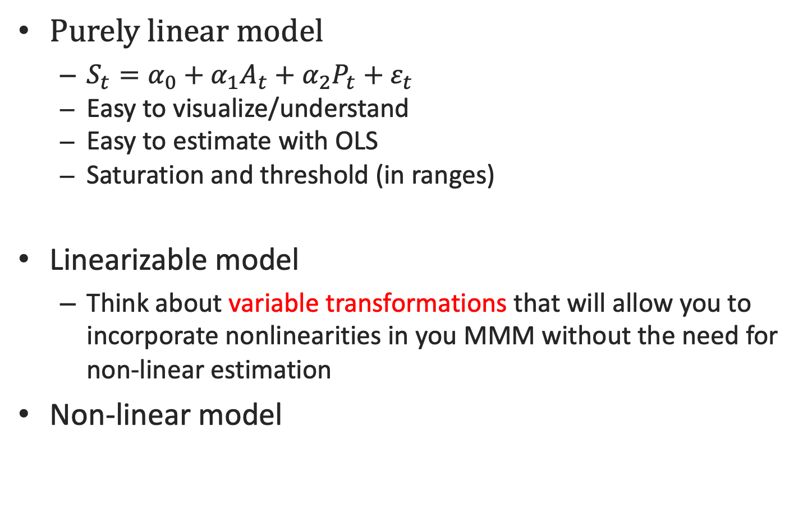
Smart MMM: Find the most parsimonious model explaining your data well
Purely linear model
$S_{t}=α_{0}+α_{1}A_{t}+α_{2}P_{t}+ε_{t}$
Easy to visualize/understand
Easy to estimate with OLS
Saturation and threshold (in ranges)
Linearizable model
Think about variable transformations that will allow you to incorporate nonlinearities in you MMM without the need for non-linear estimation
Non-linear model

Slide 16
Understanding the Mathematics of the Shapes
Convexity vs. Concavity

Slide 17








The Mathematics of Response Shapes
y
$$\frac{∂y}{∂x}<0$$
y
$$\frac{∂y}{∂x}>0$$
$$\frac{∂^{2}y}{∂x^{2}}<0$$
$$\frac{∂^{2}y}{∂x^{2}}>0$$
x
x
y
y
$$\frac{∂y}{∂x}>0$$
$$\frac{∂y}{∂x}<0$$
$$\frac{∂^{2}y}{∂x^{2}}<0$$
$$\frac{∂^{2}y}{∂x^{2}}>0$$
x
x

Slide 18
Some common models in marketing

Slide 19


Fractional Root Model
$c$ can be interpreted as elasticity when $a$ = 0
Linear, increasing or decreasing returns (depends on c)
THINK: How?
$$Y_{t}=a+bx_{1t}^{c}$$

Slide 20
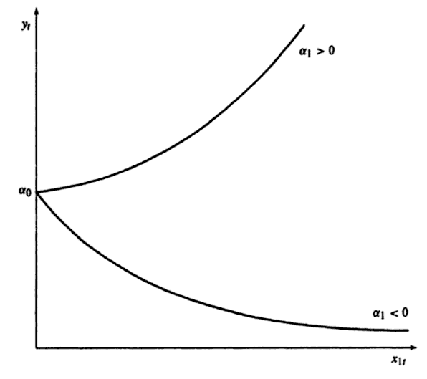

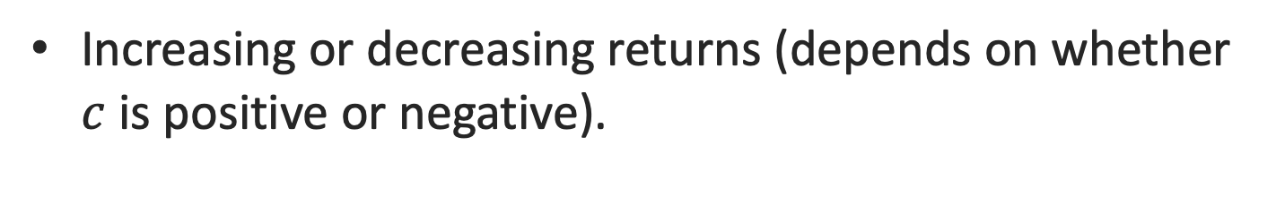




Exponential Model
$$Y_{t}=be^{cx_{1t}}$$
${(x}_{1t}>0$)
Increasing or decreasing returns (depends on whether $c$ is positive or negative).
$$c>0$$
$$b$$
Can be used to model which marketing mix variable?
$$c<0$$

Slide 21
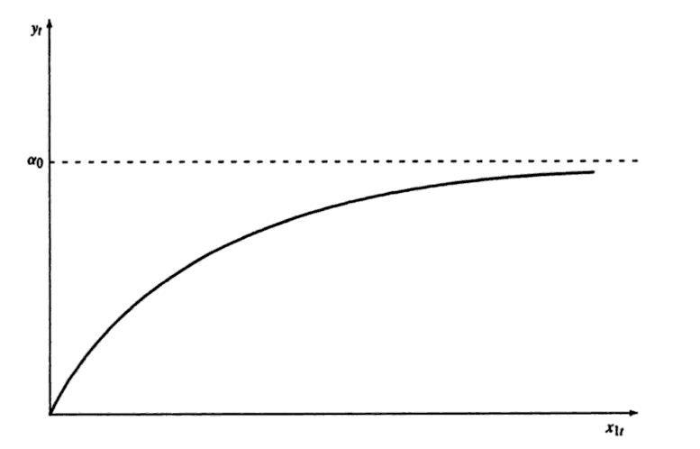

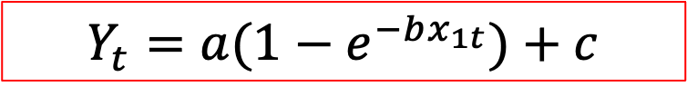

Modified Exponential Model
$$Y_{t}=a{(1−e}^{−bx_{1t}})+c$$
$${(x}_{1t}>0, a>0, b>0)$$
Decreasing returns and saturation
Widely used in marketing
$$a$$
Can be used to model which marketing mix variable?

Slide 22
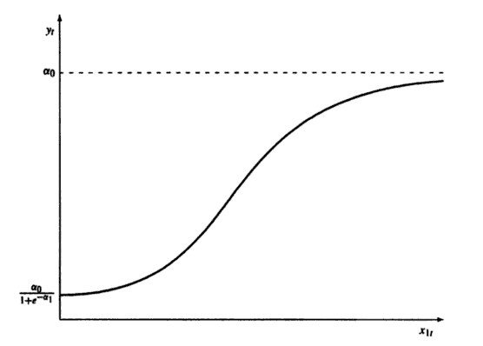

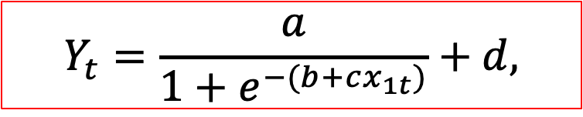


Logistic Model
Allows for S-shaped response
Saturation at ($a+d$)
Symmetrical around ($a/2+c$)
Easy to estimate
Widely used in marketing
$$Y_{t}=\frac{a}{1+e^{−(b+cx_{1t})}}+d,$$
$x_{1t}, a, b,c>0$,
$$a+d$$

Slide 23
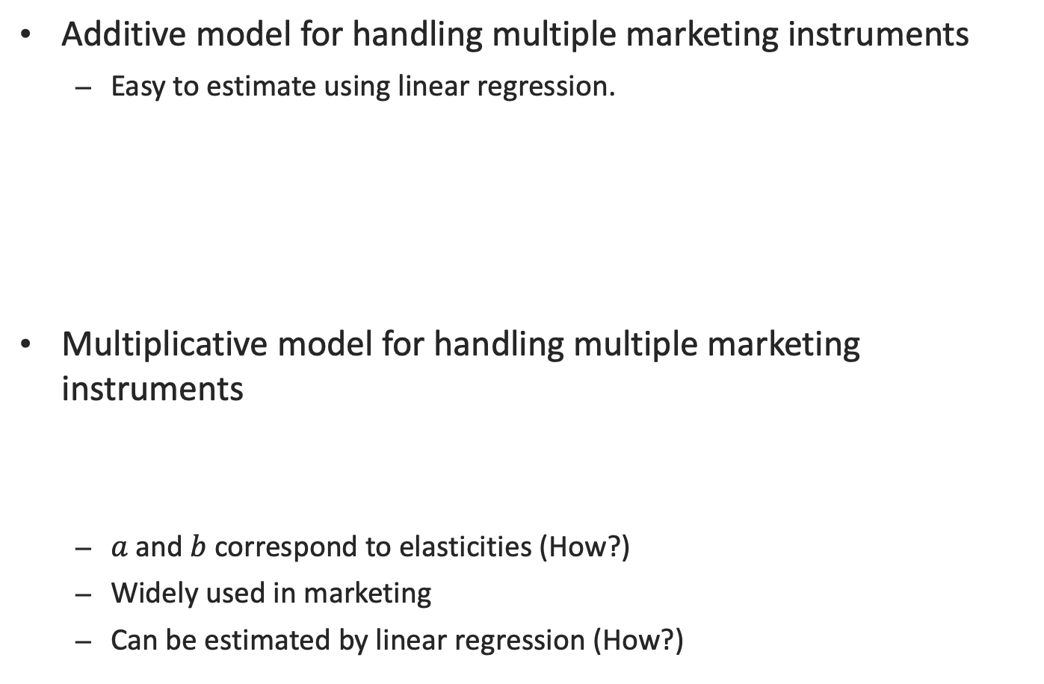

Multiple Variables and Interactions
Additive model for handling multiple marketing instruments
Easy to estimate using linear regression.
Multiplicative model for handling multiple marketing instruments
$a$ and$b$correspond to elasticities (How?)
Widely used in marketing
Can be estimated by linear regression (How?)
Main Effects
Interaction Effects
$$Y_{t}=af\left(x_{1t}\right)+bg\left(x_{2t}\right)+cf\left(x_{1t}\right)g(x_{2t})$$
$$Y_{t}=cx_{1t}^{a}x_{2t}^{b}$$

Slide 24
Issues to Consider
Model Specification
Does the model include the right variables to represent the decision situation?
Are the variables represented managerially actionable?
Does the model incorporate the expected behavior of individual variables (e.g. diminishing returns, carryover effects, or thresholds)
Model Calibration
Can the model be calibrated by using historical data, managerial judgment or through experimentation?
Model Usability
Is the model easy to use? (e.g. Simple, convey results in an understandable manner, permit user control)
Is the model easy to understand?
Does the model give guidance that makes sense?

Slide 25
Additional slides

Slide 26
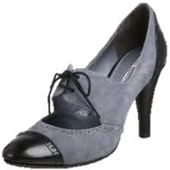
The Tipping Point
How did Hush Puppies became a huge national brand from a moribund brand sold only to the un-hip?
Three rules of epidemics:
The Law of the Few: The success of any kind of social epidemic is heavily dependent on the involvement of people with a particular and rare set of social gifts.
Connectors → bringing the world together
Mavens → Information specialists
Salesmen → persuaders
The Stickiness Factor
The Power of Context
How will it go for the Oxford shoes?

Slide 27
Verbal Model
Sales of a new product often start slowly as "innovators" in the population adopt the product. The innovators influence "imitators," leading to accelerated sales growth. As more people in the population purchase the product, sales continue to increase but sales growth slows down.

Slide 28
Box and Arrow Model
Fixed Population Size
Innovators
Imitators
Timing of Purchase by Innovators
Timing of Purchase by Imitators
Pattern of Sales Growth of New Product

Slide 29
Graphical Model
Cumulative Sales
of a Product
Fixed
Population Size
Time

Slide 30
Mathematical Model
CS_{t-1} = Total number of people who have adopted product by time t-1 S_{t} = Sales at time t M = Population size (fixed) p = Effect of innovators q = Effect of imitators
The shape of the diffusion curve depends on p and q, given that M is a constant

Slide 31
Are Models Valuable?
Belief: 'No mechanical prediction method can possibly capture the complicated cues and patterns humans use for prediction.'
Hard Fact: A host of studies in medical diagnosis, loan granting, auditing and production scheduling have shown that even simple models out-perform expert judgment.
Result: Systematic marketing decision making can improve marketing productivity by 5 to 10% with minimal additional costs (i.e., it has a very high ROI).
For best decisions, modelling and judgmental insights need to work hand-in-hand.
Notes:
Models : + Optimality, - Abstraction from reality
Survey : Good thing is they are human, bad thing is they are human. + Human intervention, insights; - Report-bias

Slide 32
Key Takeaways From This Session
Are models the whole answer? No!
Models do not solve managerial problems, people do!
Managers do not observe the opportunity costs of their decisions
They know how well they did, but they do not know if they could have done better given the resources
Decision models and mental models should be used in conjunction
Intuitive judgment may over-fit new cases to old patterns, but can capture the idiosyncratic aspects of a decision situation
Decision models are consistent and unbiased, but tend to underweight idiosyncratic aspects.
Too much data doesn't guarantee actionable insights. Being a good "data-detective" requires asking the right questions, using the right decision model and applying the right transformation to your data.
Data and analytics facilitate you to measure market performance using suitable hard and soft metrics, and justify and improve marketing decisions.

Slide 33
HANDS-ON EXERCISE
RESPONSE MODEL SIMULATION IN EXCEL

Slide 34
Goal:
Simulating aggregate market response models to advertising spending via Excel from a fixed set of parameters (of your choice)
Steps and Details
Generate two years of monthly advertising spending data from a normal distribution with mean=150 and standard deviation=30 (N(150,30))
Simulate sales using the advertising as a predictor using a fixed set of parameters (of your choice) and the following functional forms: linear, fractional root, exponential, modified exponential and logistic

